Slide 1
Chapter 4 Stochastic calculus
4.2 Ito’s Integral for Simple Integrands
報告者:
0253924張錦炘
0253926沈宣佑

Slide 2
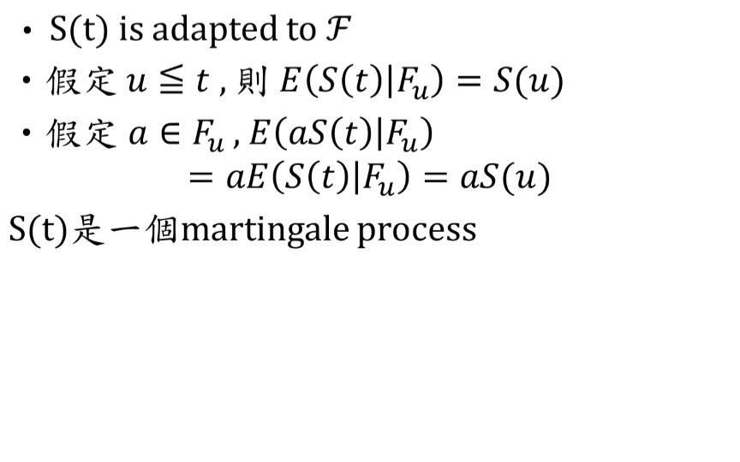
Martingale

Slide 3
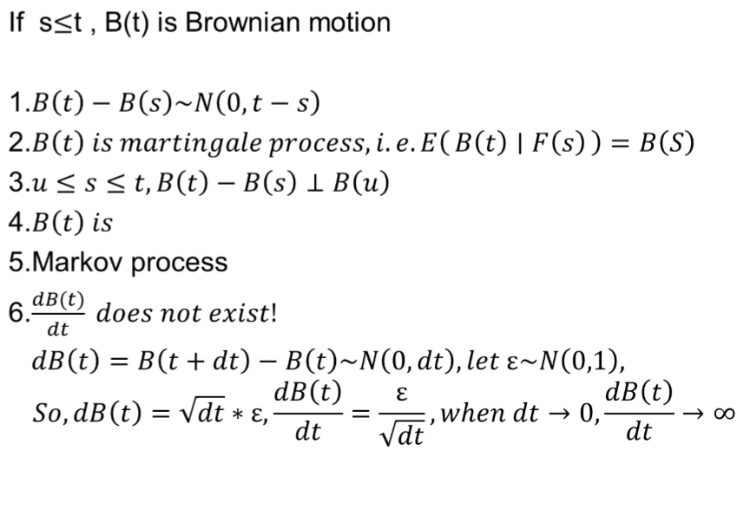

Brownian Motion

Slide 4
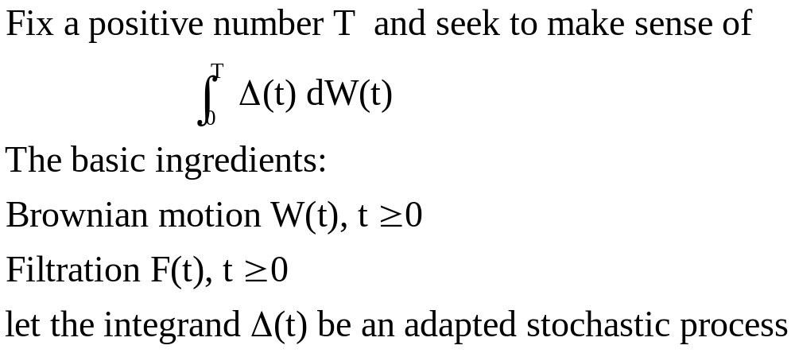
4.2 Ito’s Integral for Simple Integrands
(4.2.1)

Slide 5
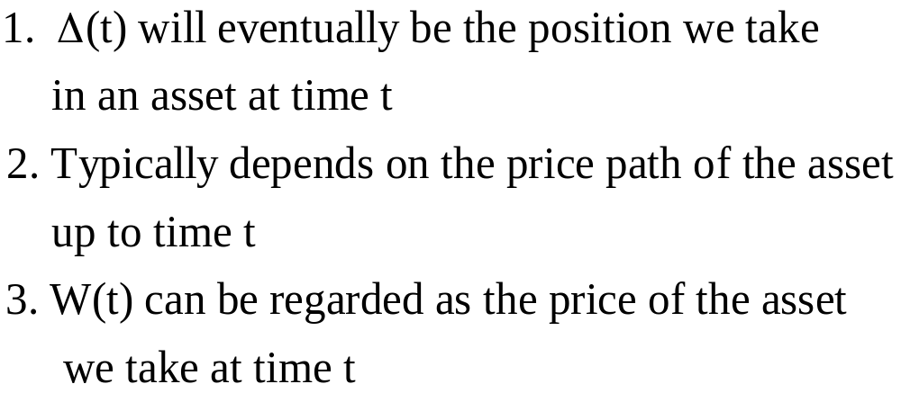
Reason for doing this:

Slide 6
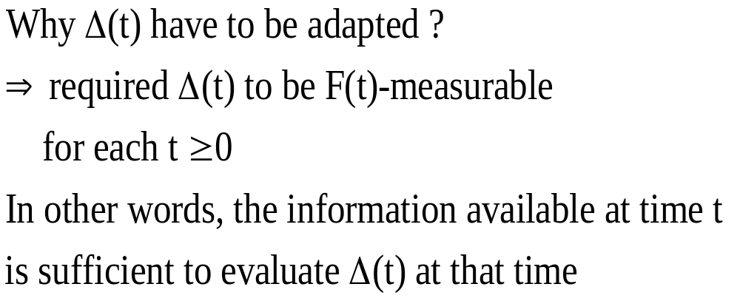

Slide 7
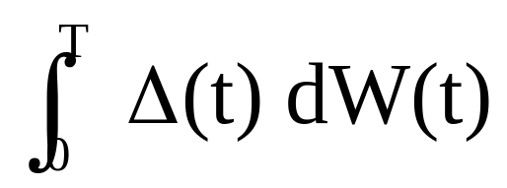
Trying to assign meaning to the Ito integral
(4.2.1)
We face the problem is that Brownian motion paths cannot be differentiated with respect to time

Slide 8
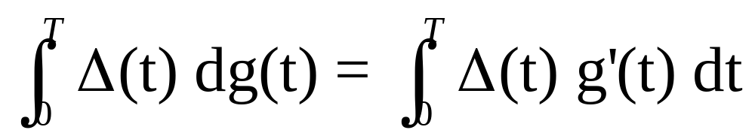
If g(t) is a differentiable function
Define
The right-hand side is an ordinary integral with respect to time

Slide 9
4.2.1 Construction of the Integral
To define the integral (4.2.1), Ito devised the following way around the non-differentiability of the Brownian motion paths
We first define the simple integrands, and then extend it to non-simple integrands as a limit of the integral of simple integrands

Slide 10
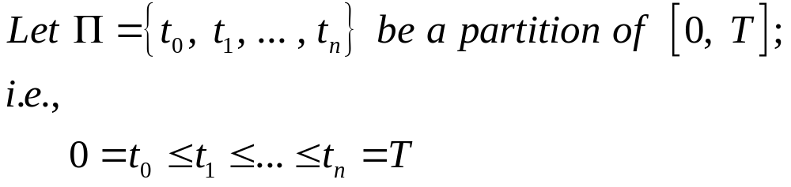
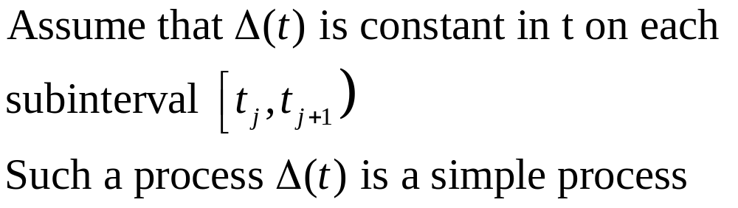
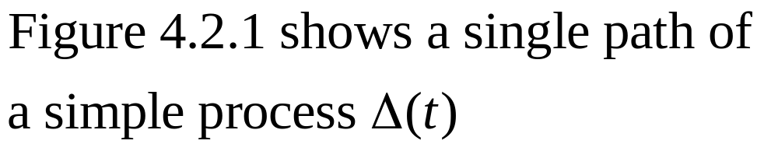

Slide 11
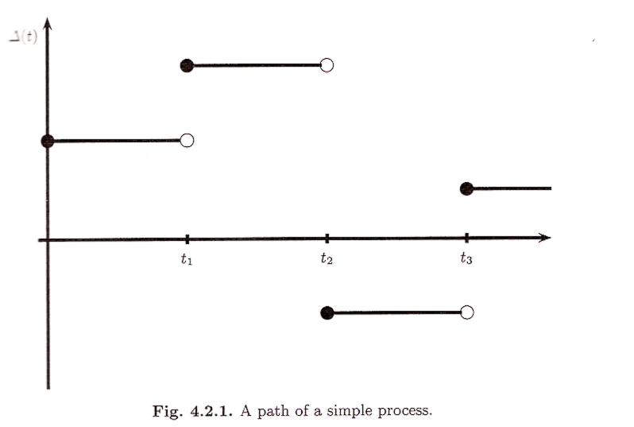

Slide 12
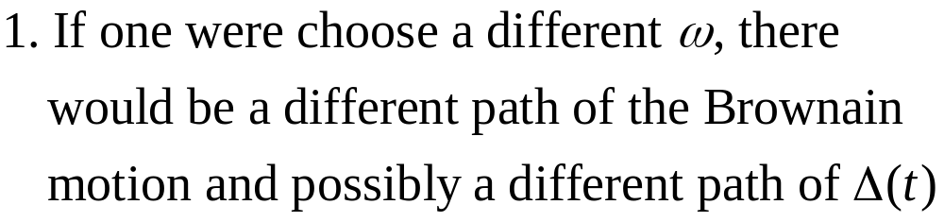
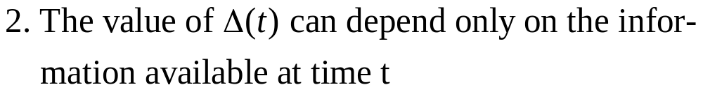
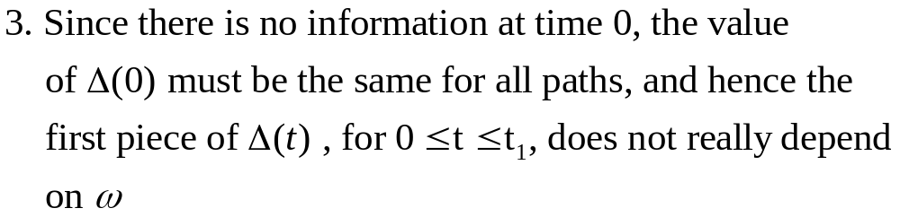
Note

Slide 13
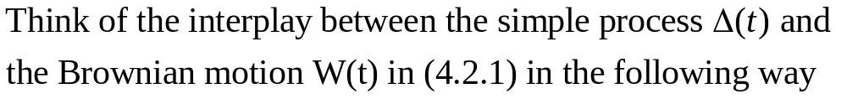
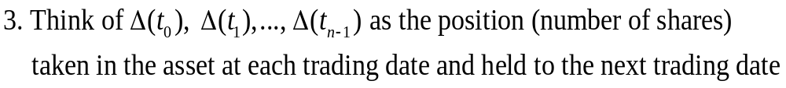

Slide 14
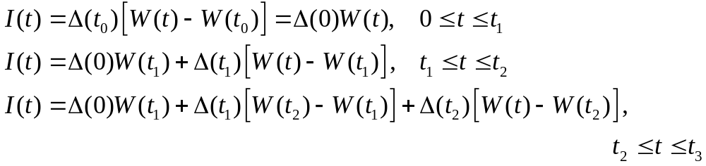
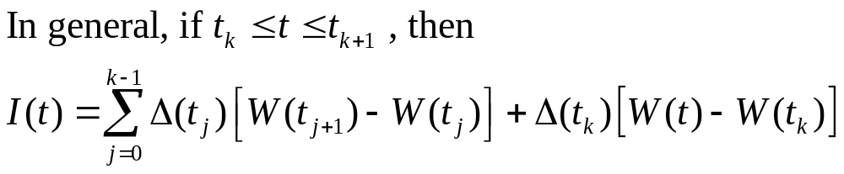
The gain from trading at each time t is given by
(4.2.2)

Slide 15
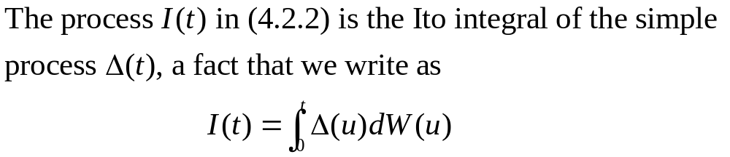
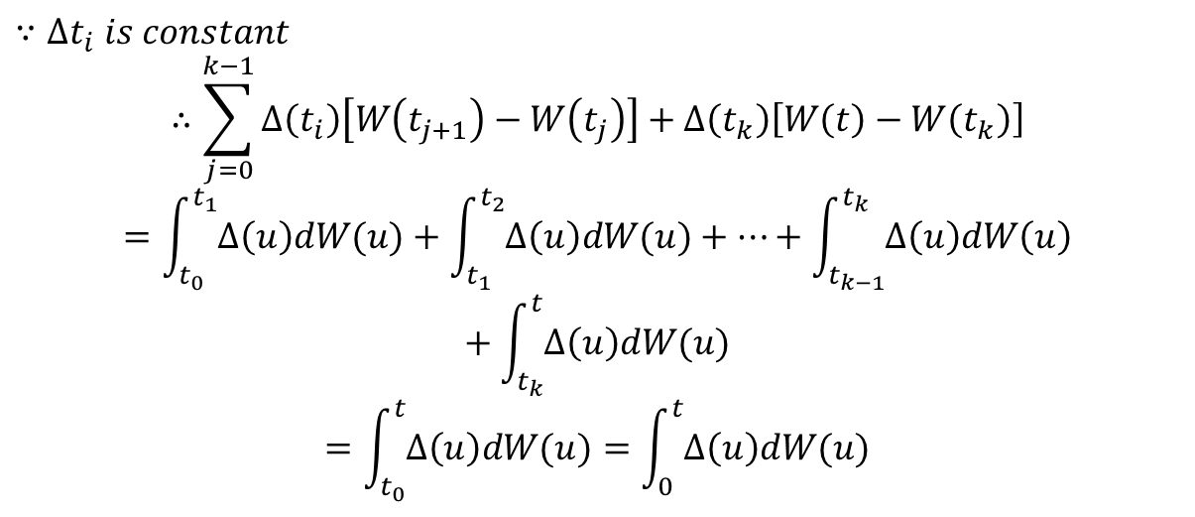

Slide 16
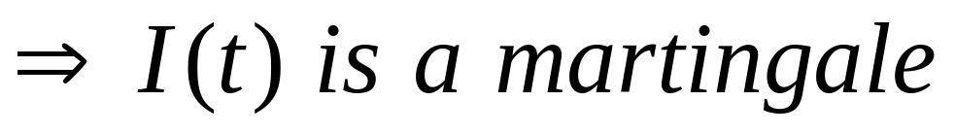
4.2.2 Properties of the Integral
The Ito integral (4.2.2) is defined as the
gain from trading in the martingale W(t)
2.I(t) can be thought of as a process in its
upper limit of integration t, and has no
tendency to rise or fall

Slide 17
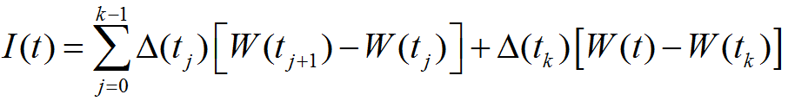
Theorem 4.2.1.
is a martingale.

Slide 18
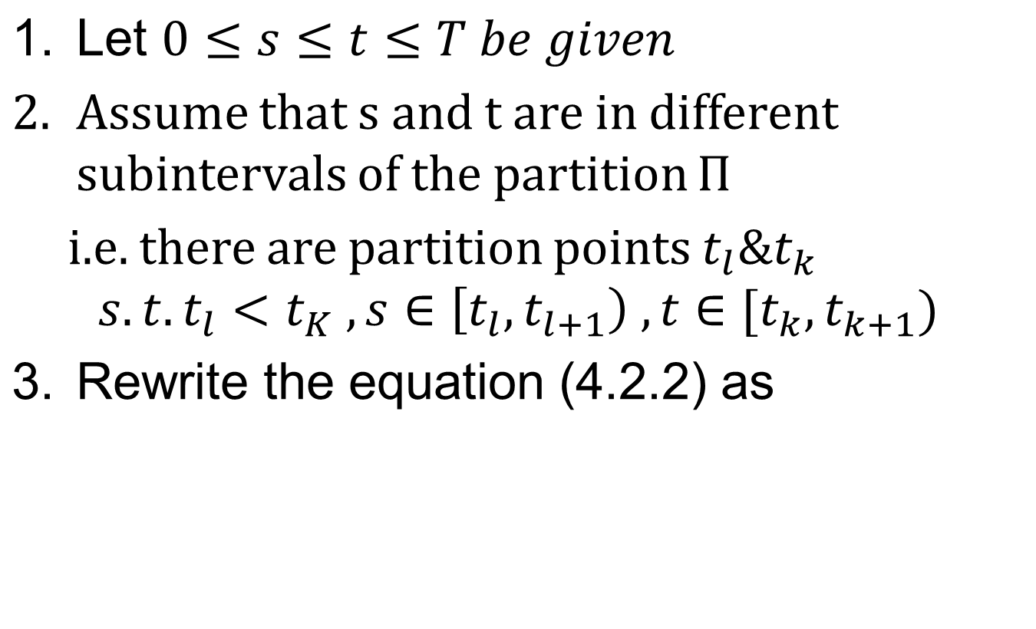
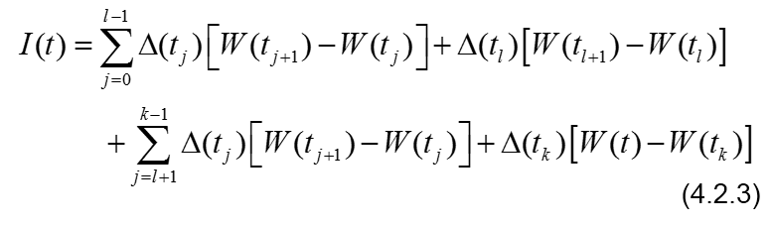
Proof:

Slide 19
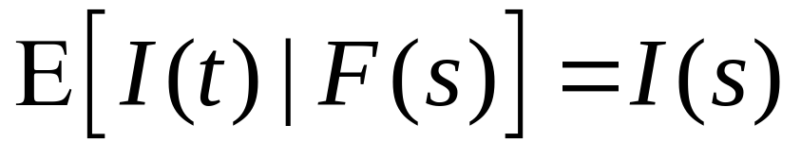
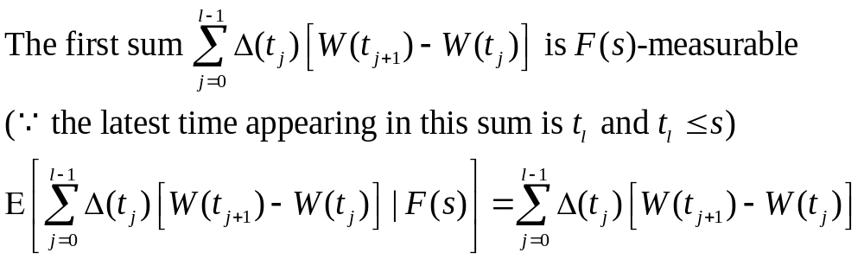
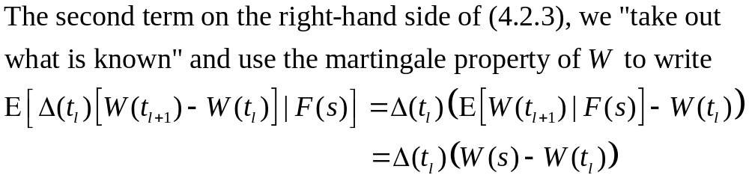
We must show that
(4.2.4)
(4.2.5)

Slide 20
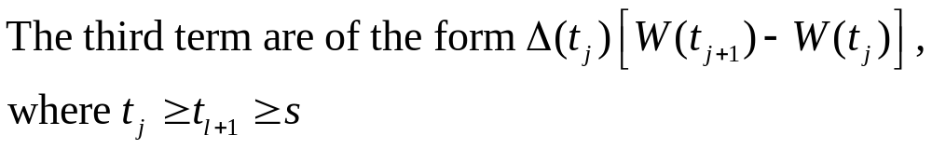
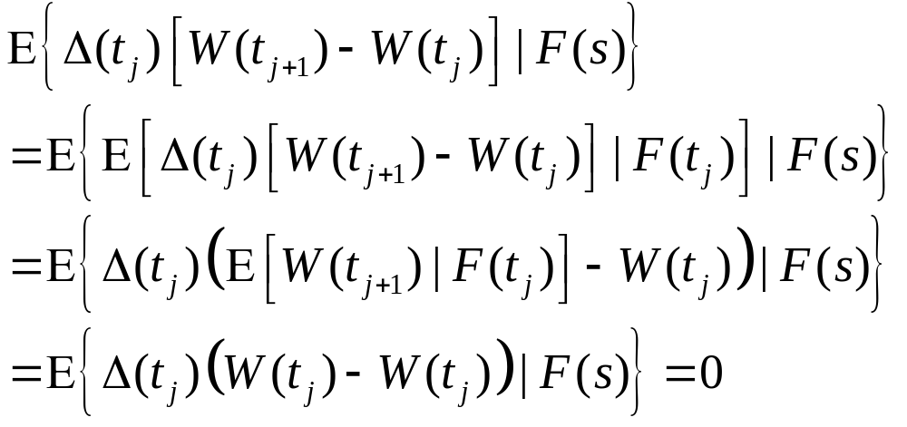
To show that the conditional expectations of the third and fourth terms on the right-hand side of (4.2.3) are zero

Slide 21
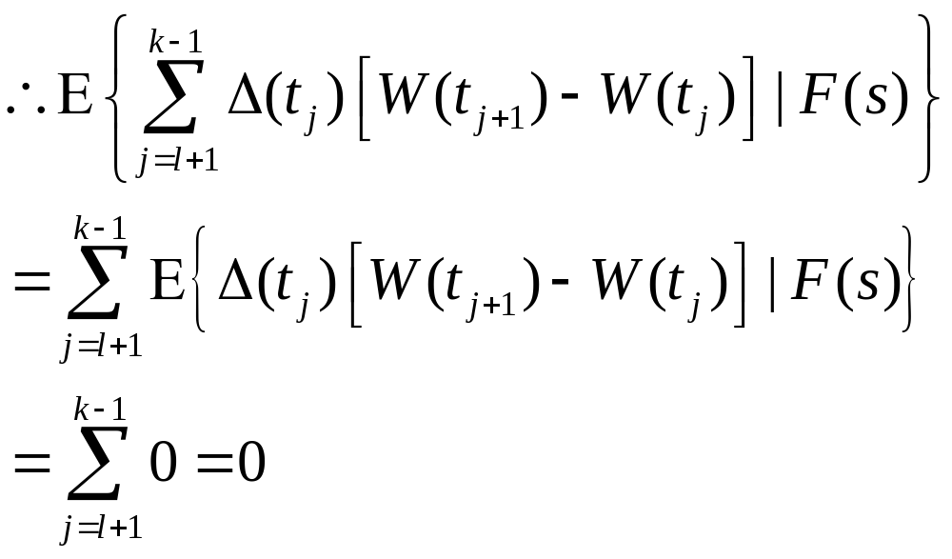

Slide 22
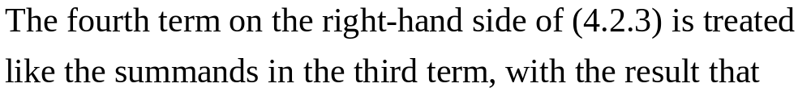
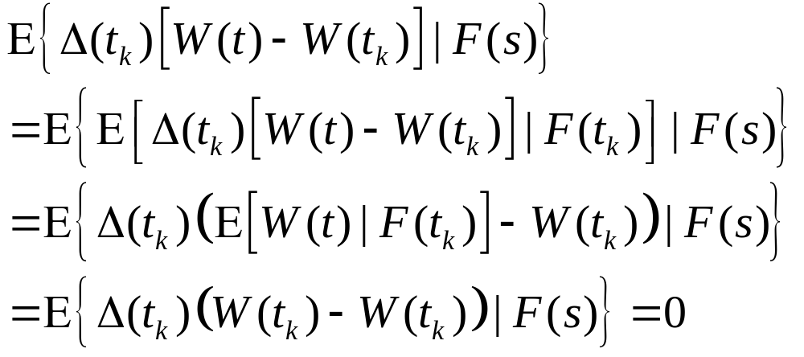

Slide 23
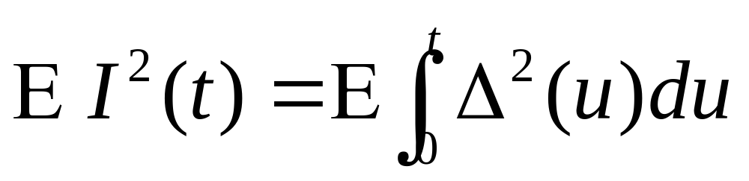
Theorem 4.2.2. (Ito isometry)
The Ito integral
satisfies
(4.2.6)

Slide 24
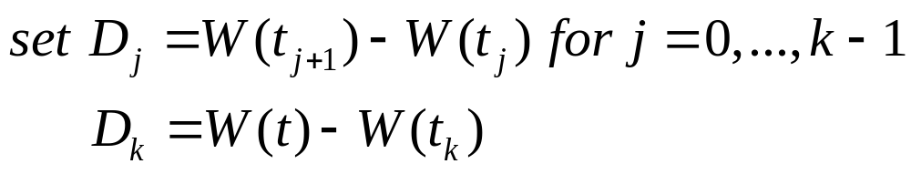
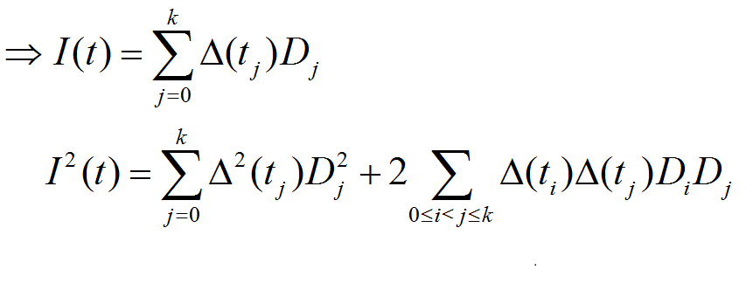
Proof:

Slide 25
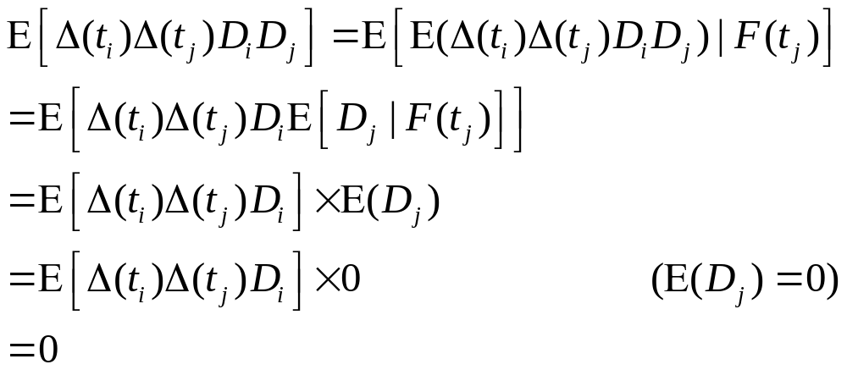

Slide 26
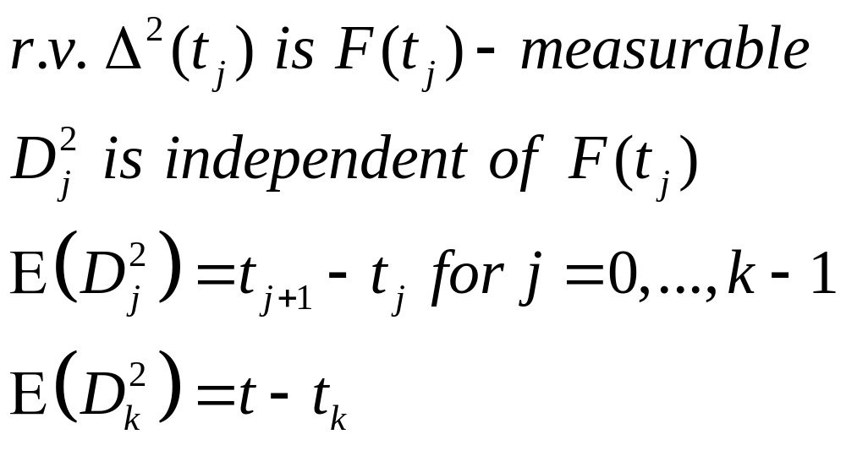
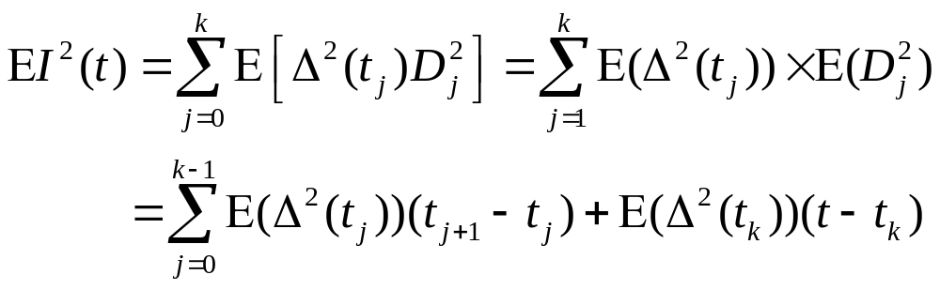
(4.2.7)

Slide 27
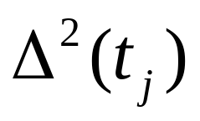
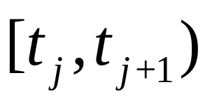
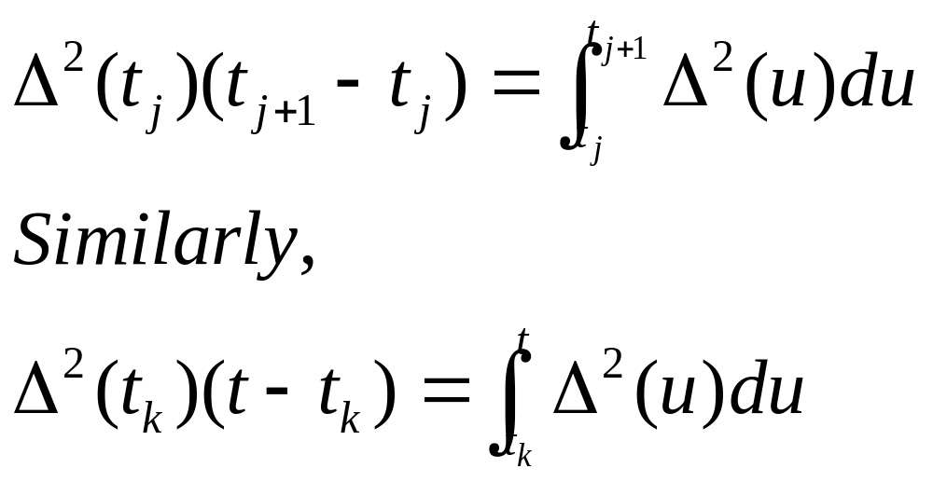
Note that is constant on the interval
, and hence
Substitute the above into equation (4.2.7)
to obtain the following equations

Slide 28
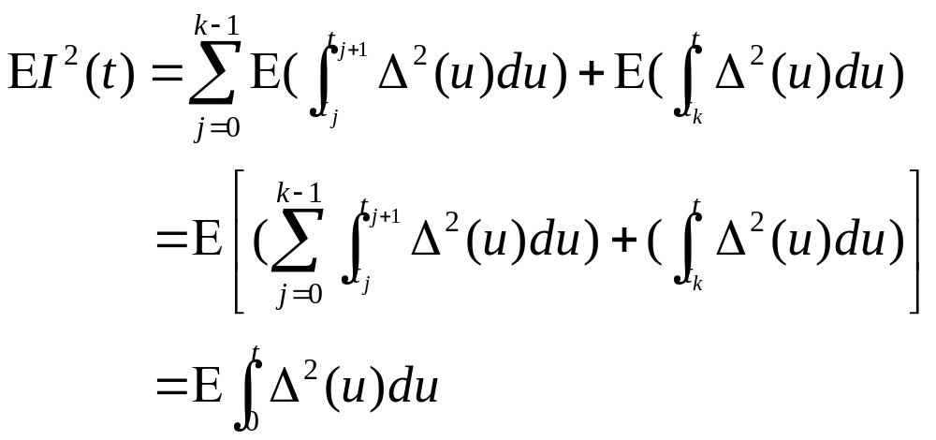

Slide 29
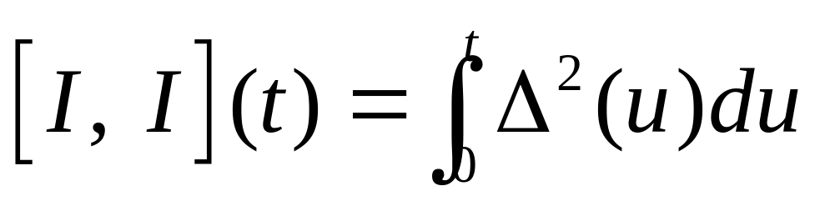
Theorem 4.2.3.
The quadratic variation accumulated up to time t by the Ito integral
is
(4.2.9)

Slide 30
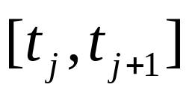
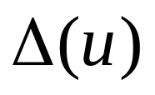
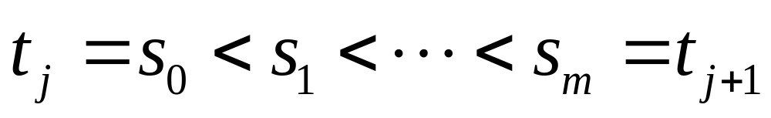
Proof:
On one of the subintervals which is constant
We first compute the quadratic variation accumulated by Ito integral, we choose partition points

Slide 31
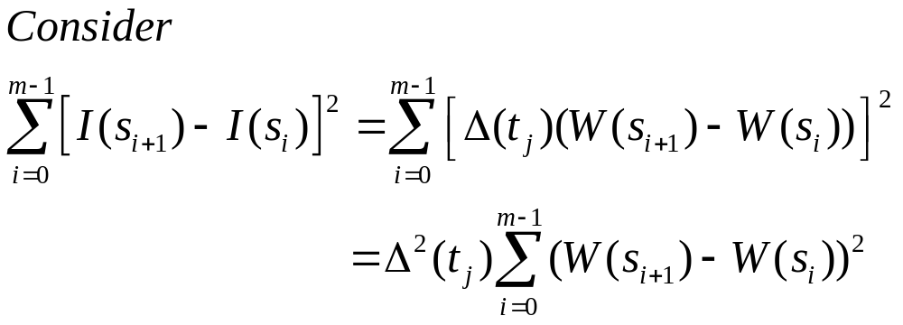
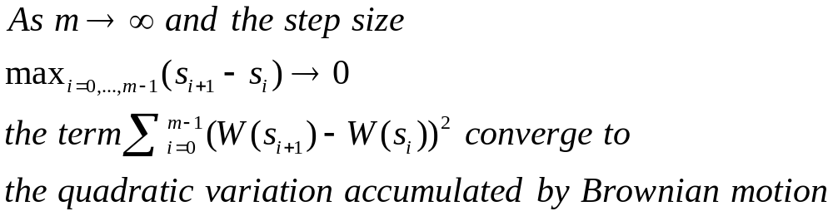
(4.2.9)

Slide 32
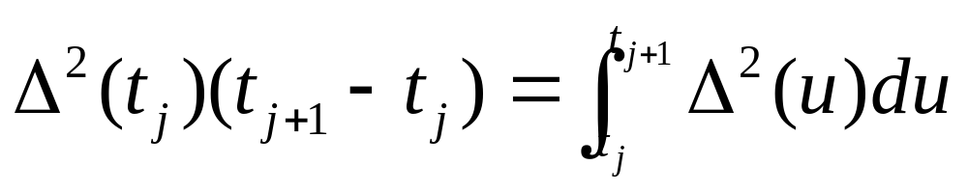
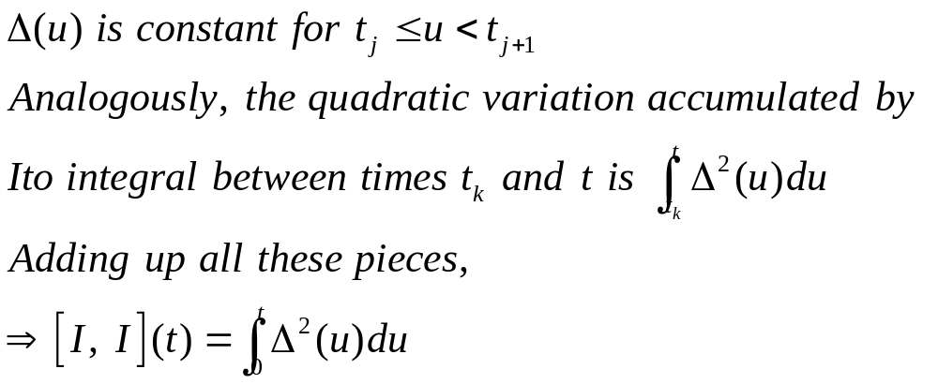
The limit of (4.2.9) is

Slide 33
The difference between Theorem 4.2.2 and 4.2.3
The quadratic variation
  is computed path-by-path, and result can depend on the path
  can be regard as a measure of risk
  depend on the size of the position we take
The variance of I(t)
  Is an average over all possible paths of quadratic variation
  can’t be random

Slide 34

The difference between Theorem 4.2.2 and 4.2.3

Slide 35





Recall the equation (3.4.10),
means that Brownian motion accumulates quadratic variation at rate one per unit time
And the Ito integral formula
can be written in differential form as
Using (3.4.10) to square
means that the Ito integral I(t) accumulates quadratic variation at rate per unit time

Slide 36


Remark 4.2.4 (on notation)
(4.2.12)
(4.2.13)

